Slide 1


The PiXL Club The PiXL Club The PiXL Club The PiXL Club The PiXL Club The PiXL Club The PiXL Club The PiXL Club The PiXL Club The PiXL Club The PiXL Club The PiXL Club The PiXL Club The PiXL Club The PiXL Club The PiXL Club The PiXL Club The PiXL Club The PiXL Club The PiXL Club The PiXL Club The PiXL Club The PiXL Club The PiXL Club The PiXL Club The PiXL Club The PiXL Club The PiXL Club The PiXL Club The PiXL Club The PiXL Club The PiXL Club The PiXL Club The PiXL Club The PiXL Club The PiXL Club The PiXL Club The PiXL Club The PiXL Club The PiXL Club The PiXL Club The PiXL Club The PiXL Club The PiXL Club The PiXL Club XL Club The PiXL Club The PiXL Club The PiXL Club The PiXL Club The PiXL Club The PiXL Club The PiXL Club The PiXL Club The PiXL Club The PiXL Club The PiXL Club The PiXL Club The PiXL Club The PiXL Club The PiXL Club The PiXL Club The PiXL Club The PiXL Club The PiXL Club The PiXL Club The PiXL Club The PiXL Club The PiXL Club The PiXL Club The PiXL Club The PiXL Club The PiXL Club The PiXL Club The PiXL Club The PiXL Club The PiXL Club The PiXL Club The PiXL Club The PiXL Club The PiXL Club The PiXL Club The PiXL Club The PiXL Club The PiXL Club The PiXL Club The PiXL Club The PiXL Club The PiXL Club The PiXL Club The PiXL Club The PiXL Club The PiXL Club The PiXL Club The PiXL Club The PiXL Club The PiXL Club The PiXL Club The PiXL Club The PiXL Club The PiXL Club The PiXL Club The PiXL Club The PiXL Club The PiXL Club The PiXL Club The PiXL Club The PiXL Club The PiXL Club The PiXL Club The PiXL Club The PiXL Club The PiXL Club The PiXL Club The PiXL Club The PiXL Club The PiXL Club The PiXL Club The PiXL Club The PiXL Club The PiXL Club The PiXL Club The PiXL Club The PiXL Club The PiXL Club The PiXL Club The PiXL Club The PiXL Club The PiXL Club The PiXL Club The PiXL Club The PiXL Club The PiXL Club The PiXL Club The PiXL Club The PiXL Club The PiXL Club The PiXL Club The PiXL Club The PiXL Club The PiXL Club The PiXL Club The PiXL Club The PiXL Club The PiXL Club The PiXL Club The PiXL Club The PiXL Club The PiXL Club The PiXL Club The PiXL Club The PiXL Club The PiXL Club The PiXL Club The PiXL Club The PiXL Club The PiXL Club The PiXL Club The PiXL Club The PiXL Club The PiXL Club The PiXL Club The PiXL Club The PiXL Club The PiXL Club The PiXL Club The PiXL Club The PiXL Club The PiXL Club The PiXL Club The PiXL Club The PiXL Club The PiXL Club The PiXL Club The PiXL Club The PiXL Club The PiXL Club The PiXL Club The PiXL Club The PiXL Club The PiXL Club The PiXL Club The PiXL Club The PiXL Club The PiXL Club The PiXL Club The PiXL Club The PiXL Club The PiXL Club The PiXL Club The PiXL Club The PiXL Club The PiXL Club The PiXL Club The PiXL Club The PiXL Club The PiXL Club The PiXL Club The PiXL Club The PiXL Club The PiXL Club The PiXL Club The PiXL Club The PiXL Club The PiXL Club The PiXL Club The PiXL Club The PiXL Club The PiXL Club The PiXL Club The PiXL Club The PiXL Club The PiXL Club The PiXL Club The PiXL Club The PiXL Club The PiXL Club The PiXL Club The PiXL Club The PiXL Club The PiXL Club The PiXL Club The PiXL Club The PiXL Club The PiXL Club The PiXL Club The PiXL Club The PiXL Club The PiXL Club The PiXL Club The PiXL Club The PiXL Club The PiXL Club The PiXL Club The PiXL Club The PiXL Club The PiXL Club The PiXL Club The PiXL Club The PiXL Club The PiXL Club The PiXL Club The PiXL Club The PiXL Club The PiXL Club The PiXL Club The PiXL Club The PiXL Club The PiXL Club The PiXL Club The PiXL Club The PiXL Club The PiXL Club The PiXL Club The PiXL Club The PiXL Club The PiXL Club The PiXL Club The PiXL Club The PiXL Club The PiXL Club The PiXL Club The PiXL Club The PiXL Club The PiXL Club The PiXL Club The PiXL Club The PiXL Club The PiXL Club The PiXL Club The PiXL Club The PiXL Club The PiXL Club The PiXL Club The PiXL Club The PiXL Club The PiXL Club The PiXL Club The PiXL Club The PiXL Club The PiXL Club The PiXL Club The PiXL Club The PiXL Club The PiXL Club The PiXL Club The PiXL Club The PiXL Club The PiXL Club The PiXL Club The PiXL Club The PiXL Club The PiXL Club The PiXL Club The PiXL Club The PiXL Club The PiXL Club The PiXL Club The PiXL Club The PiXL Club The PiXL Club The PiXL Club The PiXL Club The PiXL Club The PiXL Club The PiXL Club The PiXL Club The PiXL Club The PiXL Club The PiXL Club The PiXL Club The PiXL Club The PiXL Club The PiXL Club The PiXL Club The PiXL Club The PiXL Club The PiXL Club The PiXL Club The PiXL Club The PiXL Club The PiXL Club The PiXL Club The PiXL Club The PiXL Club The PiXL Club The PiXL Club The PiXL Club The PiXL Club The PiXL Club The PiXL Club The PiXL Club The PiXL Club The PiXL Club The PiXL Club The PiXL Club The PiXL Club The PiXL Club The PiXL Club The PiXL Club The PiXL Club The PiXL Club The PiXL Club The PiXL Club The PiXL Club The PiXL Club The PiXL Club The PiXL Club The PiXL Club The PiXL Club The PiXL Club The PiXL Club The PiXL Club The PiXL Club The PiXL Club The PiXL Club The PiXL Club The PiXL Club The PiXL Club The PiXL Club The PiXL Club The PiXL Club The PiXL Club The PiXL Club The PiXL Club The PiXL Club The PiXL Club The PiXL Club The PiXL Club The PiXL Club The PiXL Club The PiXL Club The PiXL Club The PiXL Club The PiXL Club The PiXL Club The PiXL Club The PiXL Club The PiXL Club The PiXL Club The PiXL Club The PiXL Club The PiXL Club The PiXL Club The PiXL Club The PiXL Club The PiXL Club The PiXL Club The PiXL Club The PiXL Club The PiXL Club The PiXL Club The PiXL Club The PiXL Club The PiXL Club The PiXL Club The PiXL Club The PiXL Club The PiXL Club The PiXL Club The PiXL Club The PiXL Club The PiXL Club The PiXL Club The PiXL Club The PiXL Club The PiXL Club The PiXL Club The PiXL Club The PiXL Club The PiXL Club The PiXL Club The PiXL Club The PiXL Club The PiXL Club The PiXL Club The PiXL Club The PiXL Club The PiXL Club The PiXL Club The PiXL Club The PiXL Club The PiXL Club The PiXL Club The PiXL Club The PiXL Club The PiXL Club The PiXL Club The PiXL Club The PiXL Club The PiXL Club The PiXL Club The PiXL Club The PiXL Club The PiXL Club The PiXL Club The PiXL Club The PiXL Club The PiXL Club The PiXL Club The PiXL Club The PiXL Club The PiXL Club The PiXL Club The PiXL Club The PiXL Club The PiXL Club The PiXL Club The PiXL Club The PiXL Club The PiXL Club The PiXL Club The PiXL Club The PiXL Club The PiXL Club The PiXL Club The PiXL Club The PiXL Club The PiXL Club The PiXL Club The PiXL Club The PiXL Club The PiXL Club The PiXL Club The PiXL Club The PiXL Club The PiXL Club The PiXL Club The PiXL Club The PiXL Club The PiXL Club The PiXL Club The PiXL Club The PiXL Club The PiXL Club The PiXL Club The PiXL Club The PiXL Club The PiXL Club The PiXL Club The PiXL Club The PiXL Club The PiXL Club The PiXL Club The PiXL Club The PiXL Club The PiXL Club The PiXL Club The PiXL Club The PiXL Club The PiXL Club The PiXL Club The PiXL Club The PiXL Club The PiXL Club The PiXL Club The PiXL Club The PiXL Club The PiXL Club The PiXL Club The PiXL Club The PiXL Club The PiXL Club The PiXL Club The PiXL Club The PiXL Club The PiXL Club The PiXL Club The PiXL Club The PiXL Club The PiXL Club The PiXL Club The PiXL Club The PiXL Club The PiXL Club The PiXL Club The PiXL Club The PiXL Club The PiXL Club The PiXL Club The PiXL Club The PiXL Club The PiXL Club The PiXL Club The PiXL Club The PiXL Club The PiXL Club The PiXL Club The PiXL Club The PiXL Club The PiXL Club The PiXL Club The PiXL Club The PiXL Club The PiXL Club The PiXL Club The PiXL Club The PiXL Club The PiXL Club The PiXL Club The PiXL Club The PiXL Club The PiXL Club The PiXL Club The PiXL Club The PiXL Club The PiXL Club The PiXL Club The PiXL Club The PiXL Club The PiXL Club The PiXL Club The PiXL Club The PiXL Club The PiXL Club The PiXL Club The PiXL Club The PiXL Club The PiXL Club The PiXL Club The PiXL Club The PiXL Club The PiXL Club The PiXL Club The PiXL Club The PiXL Club The PiXL Club The PiXL Club The PiXL Club The PiXL Club The PiXL Club The PiXL Club The PiXL Club The PiXL Club The PiXL Club The PiXL Club The PiXL Club The PiXL Club The PiXL Club The PiXL Club The PiXL Club The PiXL Club The PiXL Club The PiXL Club The PiXL Club The PiXL Club The PiXL Club The PiXL Club The PiXL Club The PiXL Club The PiXL Club The PiXL Club The PiXL Club The PiXL Club The PiXL Club The PiXL Club The PiXL Club The PiXL Club The PiXL Club The PiXL Club The PiXL Club The PiXL Club The PiXL Club The PiXL Club The PiXL Club The PiXL Club The PiXL Club The PiXL Club The PiXL Club The PiXL Club The PiXL Club The PiXL Club The PiXL Club The PiXL Club The PiXL Club The PiXL Club The PiXL Club The PiXL Club The PiXL Club The PiXL Club The PiXL Club The PiXL Club The PiXL Club The PiXL Club The PiXL Club The PiXL Club The PiXL Club The PiXL Club The PiXL Club The PiXL Club The PiXL Club The PiXL Club The PiXL Club The PiXL Club The PiXL Club The PiXL Club The PiXL Club The PiXL Club The PiXL Club The PiXL Club The PiXL Club The PiXL Club The PiXL Club The PiXL Club The PiXL Club The PiXL Club The PiXL Club The PiXL Club The PiXL Club The PiXL Club The PiXL Club The PiXL Club The PiXL Club The PiXL Club The PiXL Club The PiXL Club The PiXL Club The PiXL Club The PiXL Club The PiXL Club The PiXL Club The PiXL Club The PiXL Club The PiXL Club The PiXL Club The PiXL Club The PiXL Club The PiXL Club The PiXL Club The PiXL Club The PiXL Club The PiXL Club The PiXL Club The PiXL Club The PiXL Club The PiXL Club The PiXL Club The PiXL Club The PiXL Club The PiXL Club The PiXL Club The PiXL Club The PiXL Club The PiXL Club The PiXL Club The PiXL Club The PiXL Club The PiXL Club The PiXL Club The PiXL Club The PiXL Club The PiXL Club The PiXL Club The PiXL Club The PiXL Club The PiXL Club The PiXL Club The PiXL Club The PiXL Club The PiXL Club The PiXL Club The PiXL Club The PiXL Club The PiXL Club The PiXL Club The PiXL Club The PiXL Club The PiXL Club The PiXL Club The PiXL Club The PiXL Club The PiXL Club The PiXL Club The PiXL Club The PiXL Club The PiXL Club The PiXL Club The PiXL Club The PiXL Club The PiXL Club The PiXL Club The PiXL Club The PiXL Club The PiXL Club The PiXL Club The PiXL Club The PiXL Club The PiXL Club The PiXL Club The PiXL Club The PiXL Club The PiXL Club The PiXL Club The PiXL Club The PiXL Club The PiXL Club The PiXL Club The PiXL Club The PiXL Club The PiXL Club The PiXL Club The PiXL Club The PiXL Club The PiXL Club The PiXL Club The PiXL Club
PiXL KnowIT!
GCSE Chemistry
AQA Topic – Chemical changes
© Copyright The PiXL Club Ltd, 2017
This resource is strictly for the use of member schools for as long as they remain members of The PiXL Club. It may not be copied, sold nor transferred to a third party or used by the school after membership ceases. Until such time it may be freely used within the member school.
All opinions and contributions are those of the authors. The contents of this resource are not connected with nor endorsed by any other company, organisation or institution.
www.pixl.org.uk The PiXL Club Ltd, Company number 07321607

Slide 2
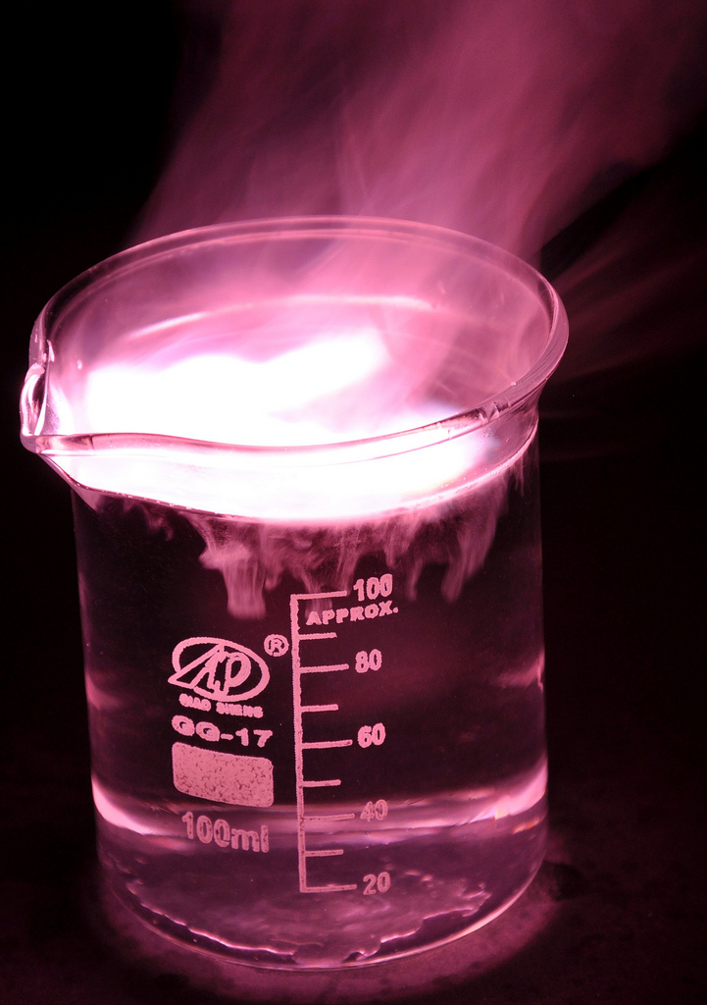
Overview
Chemical changes
Reactivity of metals
  Metal oxides
  The reactivity series
  Extraction of metals by reduction
  Oxidation and reduction in terms of electrons (HT)
Reactions of acids
  Metals and acids
  Strong and weak acids (HT)
  pH scale and Neutralisation
  Salts
  Titration (chemistry only)
Electrolysis
  Electrolysis of molten ionic compounds
  Electrolysis of an aqueous solution
  Using electrolysis to extract metals
  Representation at electrodes as half equations (HT)
Notes:
https://c2.staticflickr.com/4/3178/4076380768_03994aed44_b.jpg

Slide 3

LearnIT!
KnowIT!
Reactivity of metals
  Metals oxides
  The reactivity series
  Extracting metals by
  reduction
  Oxidation and reduction in terms of electrons (HT)

Slide 4
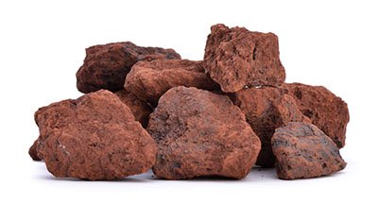
  Metal Oxides
A metal compound within a rock is an ore. Ores are mined and then purified.
Whether it is worth extracting a particular metal depends on:
How easy it is to extract it from its ore
How much metal the ore contains
The changing demands for a particular metal
Most metals in ores are chemically bonded to other elements in compounds. Many of these metals have been oxidised (have oxygen added) by oxygen in the air to form their oxides.
Iron + oxygen → iron (III) oxide
4Fe(s) + 3O₂(g) → 2Fe₂O₃(s)
To extract metals from their oxides, the metal oxides must be reduced (have oxygen removed).

Slide 5
  Reactivity series
Metals can be arranged in order of reactivity in a reactivity series.
Order of reactivity | Reaction with water | Reaction with acid
Potassium | Fizz, giving off hydrogen gas and leaving an alkaline solution of metal hydroxide | Reacts violently and explodes
Sodium
Lithium
Calcium |  | Fizz, giving off hydrogen gas and forming a salt
Magnesium | Very slow reaction
Aluminium
Zinc
Iron
Tin | No reaction with water at room temperature | React slowly with warm acid
Lead
Copper | No reaction | No reaction
Silver
Gold

Slide 6
  Reactivity series
Metals can be arranged in order of reactivity in a reactivity series.
When metals react with other substances the metal atoms form positive ions.
The reactivity of a metal is linked to its tendency to form positive ions.
The non-metals hydrogen and carbon are often included in the series as they can be used to extract less reactive metals.
Metal + acid → salt + hydrogen
Increasing reactivity
Potassium
Sodium
Lithium
Calcium
Magnesium
CARBON
Zinc
Iron
Lead
HYDROGEN
Copper
Silver
Gold

Slide 7
  Extracting metals
The reactivity of a metal determines the method of extraction.
Metals above carbon must be extracted from their ores by using electrolysis.
Metals below carbon can be extracted from their ores by reduction using carbon.
REDUCTION involves the loss of oxygen.
metal oxide + carbon → metal + carbon dioxide
Potassium
Sodium
Calcium
Magnesium
Aluminium
CARBON
Increasing reactivity
Zinc
Iron
Lead
HYDROGEN
Copper
Silver
Gold
Platinum
Gold and silver do not need to be extracted.
They occur native (naturally).

Slide 8
  Oxidation and reduction in terms of electrons (HT)
Higher:
OILRIG
Oxidation Is Loss of electrons
Reduction Is Gain of electrons
When reactions involve oxidation and reduction, they are known as redox reactions
A more reactive metal can displace a less reactive metal
from its compound in displacement reactions.
Iron + copper(II) sulfate → iron sulfate + copper
Fe(s) + CuSO₄(aq) → FeSO₄(aq) + Cu(s)
Higher:
An ionic equation shows only the atoms and ions that change in a reaction:
Fe(s) + Cu²⁺(aq) → Fe²⁺(aq) + Cu(s)
Half equations show what happens to each reactant:
Fe → Fe ²⁺ + 2e –
Cu ²⁺ + 2e – → Cu
The iron atoms are oxidised (lose 2 electrons) to form ions.
The 2 electrons from the iron are gained (reduction) by copper ions as they become atoms.

Slide 9

QuestionIT!
Extracting metals
  The reactivity series
  Metals oxides
  Extracting metals by
  reduction

Slide 10
  Extracting metals – QuestionIT
What is an ore?
What is produced when metals react with oxygen?
What is this process called and why?
What is reduction in terms of oxygen?
What type of ions do metals produce?
Which is more reactive potassium or iron?
Which two non-metals can be included in the reactivity series?

Slide 11
  Extracting metals – QuestionIT
Why is gold found as an element in the Earth?
How are metals, less reactive than carbon, extracted from their ores?
HT: Describe oxidation in terms of electrons.
HT: Describe reduction in terms of electrons.
Write the word equation for the reaction between lithium and water.

Slide 12

AnswerIT!
Extracting metals
  The reactivity series
  Metals oxides
  Extracting metals by
  reduction

Slide 13
  Extracting metals – QuestionIT
What is an ore?
  Metal compound in a rock.
What is produced when metals react with oxygen?
  Metal oxide.
What is this process called and why?
  Oxidation, gain of oxygen.
What is reduction in terms of oxygen?
  Loss of oxygen.
What type of ions do metals produce?
  Positive.
Which is more reactive potassium or iron?
  Potassium.
Which two non-metals can be included in the reactivity series?
  Carbon and hydrogen.

Slide 14
  Extracting metals – QuestionIT
Why is gold found as an element in the Earth?
  Unreactive metal.
How are metals, less reactive than carbon, extracted from their ores?
  Reduction with carbon.
HT: Describe oxidation in terms of electrons.
  OIL – loss of electrons
HT: Describe reduction in terms of electrons.
  RIG – gain of electrons
Write the word equation for the reaction between lithium and water.
  lithium + water → lithium hydroxide + hydrogen

Slide 15
  Extracting metals – QuestionIT
Write the balanced symbol equation for the reaction between lithium and water.
  2Li(s) + 2H₂O(l) → 2LiOH(aq) + H₂(g)
HT: Zinc can be extracted from zinc oxide by heating it with carbon in the blast furnace. Carbon monoxide is also produced. Which reactant is:
a) Oxidised? Carbon
b) Reduced? Zinc oxide

Slide 16
LearnIT!
KnowIT!
Reactions of acids
PART 1
  Acids and metals
  Neutralisation of acids
  Soluble salts

Slide 17
  Reactions of acids - PART 1
Acids react with some metals to produce salts and hydrogen.
Metal + acid → salt + hydrogen
Reactions between metals and acids only occur if the metal is more reactive than the hydrogen in the acid. If the metal is too reactive, the reaction with acid is violent.
The salt that is made depends on the metal and acid used.
Salts made when metals react nitric acid are called nitrates.
Zinc + Nitric acid → Zinc Nitrate + Hydrogen
Salts made when metals react with sulfuric acids are called sulfates.
Iron + Sulfuric Acid → Iron Sulfate + Hydrogen
Salts made when metals react with hydrochloric acid are called chlorides.
Magnesium + Hydrochloric acid → Magnesium Chloride + Hydrogen

Slide 18
  Reactions of acids - PART 1 - HIGHER
In the reaction between magnesium and hydrochloric acid, the hydrogen ions are displaced from the solution by magnesium as the magnesium is more reactive than hydrogen.
The following ionic equation occurs:
Mg(s) + 2H⁺(aq) → Mg²⁺(aq) + H₂(g)
The chloride ions are not included as they do not change in the reaction. These are known as spectator ions.
The reaction can be further represented by half equations, showing that the reaction between a metal and acid is a redox reaction.
Mg → Mg²⁺ + 2e –
The magnesium atoms lose two electrons, they have been oxidised.
2H⁺ + 2e ⁻ → H₂
The hydrogen ions have gained electrons, they have been reduced.

Slide 19
  Reactions of acids - PART 1
Acids are neutralised by alkalis (eg: soluble metal hydroxides) and bases (eg: insoluble metal hydroxides and metal oxides) to produce salts and water and by metal carbonates to produce salts, water and carbon dioxide.
The salt name depends on the acid used and the positive ions in the alkali, base or carbonate.
Salts are made of positive metal ions
(or ammonia ions - NH₄⁺) and a negative
ion from the acid. Like all ionic
compounds, salts have no overall charge,
so once you know the charges on the ions,
you can work out the formula.
Example: magnesium sulfate is MgSO₄
Making Soluble Salts from acids and alkalis
Salts can be made by reacting an acid with an alkali.
Acid + Alkali → Salt + Water
Making Soluble Salts from acids and bases
Salts can be made by reacting an acid with a insoluble base.
Acid + Bases → Salt + Water
Making Soluble Salts from acids and metal carbonates
Salts can be made by reacting an acid with a metal carbonate.
Acid + Metal carbonate → Salt + Water + Carbon dioxide
ion | formula | ion | formula
Group 1 | Li⁺ Na⁺ K⁺ | Transition metals | Cu²⁺ Fe³⁺
Group 2 | Mg²⁺ Ca²⁺ | Group 7 | F⁻ Cl⁻ Br⁻
Aluminium | Al³⁺ | Nitrate | NO₃⁻
Ammonium | NH₄⁺ | Sulphate | SO₄²⁻

Slide 20

  Reactions of acids - PART 1
Soluble salts can be made from acids by reacting them with solid insoluble substances, such as metals, metal oxides, hydroxides or carbonates. The solid is added to the acid until no more reacts and the excess solid is filtered off to produce a solution of the salt. Salt solutions can be crystallised to produce solid salts. You will complete this as a required practical.
Measure the required volume of acid with a measuring cylinder and add the weighed solid (insoluble metal, oxide, hydroxide or carbonate) in small portions with stirring.
Safety goggles required - the mixture may be heated to speed up the reaction. When no more of the solid dissolves it means ALL the acid is neutralised and there should be a little excess solid. You should see a residue of the solid (oxide, hydroxide, carbonate) left at the bottom of the beaker.
Filter the solution to remove the excess solid metal/oxide/carbonate, into an evaporating dish. On filtration, only a solution of the salt is left.
Then hot concentrated solution is left to cool and crystallise. After crystallisation, you collect and dry the crystals with a filter paper.
If the solution is heated, the solvent will evaporate faster. Heating a
solution until all the solvent has evaporated is known as heating to dryness.
Notes:
https://www.google.co.uk/url?sa=i&rct=j&q=&esrc=s&source=images&cd=&cad=rja&uact=8&ved=0ahUKEwjl6OrzgdHVAhXKOxQKHVXZCWMQjRwIBw&url=http%3A%2F%2Fwww.docbrown.info%2Fpage03%2FAcidsBasesSalts06b.htm&psig=AFQjCNEGXguuSJFjPV4Fhv0gS1lj7C5dJw&ust=1502603833131650

Slide 21
QuestionIT!
Reactions of acids
PART 1
  Acids and metals
  Neutralisation of acids
  Soluble salts

Slide 22
  Reactions of acids – QuestionIT
What is produced when acids react with metals?
HT: What is a redox reaction?
What is produced when an acid reacts with a carbonate?
What salt is produced by the following acids?
  Hydrochloric acid
  Sulfuric acid
  Nitric acid
How are soluble salts made from acids and insoluble substances?
Name the process of producing solid salts from salt solution.

Slide 23
  Reactions of acids – QuestionIT
Complete the following equations:
a) magnesium + sulfuric acid →
b) sodium hydroxide + hydrochloric acid →
c) lithium carbonate + nitric acid →
Write a balanced symbol equation, with state symbols, for the reaction between zinc and hydrochloric acid.
9. Higher:
Write an ionic equation, with state symbols, to show magnesium
reacting with hydrochloric acid.

Slide 24
AnswerIT!
Reactions of acids
PART 1
  Acids and metals
  Neutralisation of acids
  Soluble salts

Slide 25
  Reactions of acids – QuestionIT
What is produced when acids react with metals?
  Salt + water.
HT: What is a redox reaction?
  Oxidation and reduction.
What is produced when an acid reacts with a carbonate?
  Salt + water + carbon dioxide.
What salt is produced by the following acids?
  Hydrochloric acid Chloride
  Sulfuric acid Sulfate
  Nitric acid Nitrate
How are soluble salts made from acids and insoluble substances?
  Solid added to acid until no more reacts; excess solid filtered off.
Name the process of producing solid salts from salt solution.
  Crystallisation.

Slide 26
  Reactions of acids – QuestionIT
Complete the following equations:
a) magnesium + sulfuric acid → magnesium sulfate + hydrogen
b) sodium hydroxide + hydrochloric acid → sodium chloride + water
c) lithium carbonate + nitric acid → lithium nitrate + water +
carbon dioxide
Write a balanced symbol equation, with state symbols, for the reaction between zinc and hydrochloric acid.
Zn(s) + 2HCl(aq) → ZnCl₂(aq) + H₂(g)
9. Higher:
Write an ionic equation, with state symbols, to show magnesium
reacting with hydrochloric acid.
Mg(s) + 2H⁺(aq) → Mg²⁺(aq) + H₂(g)

Slide 27
LearnIT!
KnowIT!
Reactions of acids
PART 2
  pH and neutralisation
  Titration (chemistry only)
  Strong and weak acids (HT)

Slide 28
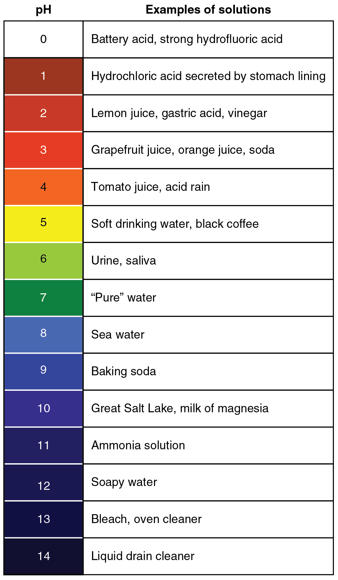
  Reactions of acids - PART 2
Indicators are substances which change colour when you add them to acids and alkali.
Litmus goes red in acid and blue in alkali.
Universal indicator, made from many dyes is used to tell you pH. The scale runs from 0 (most acidic) to 14 (most alkaline). Aqueous solutions of acids have a pH value less than 7, and for alkalis greater than 7 and anything in the middle is neutral (pH 7). You can use a pH meter to record the change of a pH over time.
Acids produce hydrogen ions (H⁺) in aqueous solutions and alkalis produce hydroxide ions (OH–).
In neutralisation reactions between an acid and alkali, hydrogen ions react with hydroxide ions to produce water.
Neutralisation symbol equation:
H⁺(aq) + OH–(aq) ➞ H₂O(l)
Notes:
https://opentextbc.ca/anatomyandphysiology/wp-content/uploads/sites/142/2016/03/2713_pH_Scale-01.jpg

Slide 29
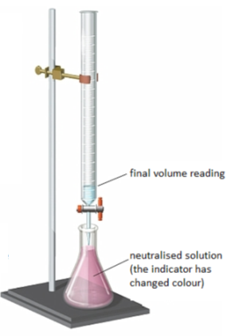
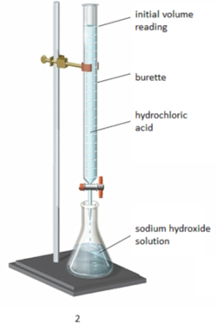
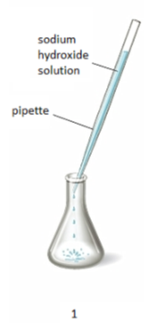
  Reactions of acids - PART 2 - CHEMISTRY ONLY
The volumes of acid and alkali solutions that react with each other
can be measured by titration using a suitable indictor.
3. Stop adding the acid when the end-point is reached (the appropriate colour change in the indicator happens). Note the final volume reading. Repeat steps 1 to 3 until you get consistent readings.
Use the pipette to add 25 cm³ of alkali to a conical flask and add a few drops of indicator.
2. Fill the burette with acid and note the starting volume. Slowly add the acid from the burette to the alkali in the conical flask, swirling to mix.
Notes:
https://www.google.co.uk/url?sa=i&rct=j&q=&esrc=s&source=images&cd=&cad=rja&uact=8&ved=0ahUKEwirr9O3pNHVAhUHvRQKHZ_IAe0QjRwIBw&url=https%3A%2F%2Ftaytaynm.wordpress.com%2F2014%2F05%2F01%2Fwho-cares-about-titration%2F&psig=AFQjCNHoK3AhdASNaybmu_T9HzIcQoxVjg&ust=1502612966877529

Slide 30
  Reactions of acids – PART 2 – CHEMISTRY ONLY
  Higher
The concentration of a solution is the amount of solute per volume of solution.
Chemists measure concentration in moles per cubic decimetre (mol/dm³).
Where:
n is the number of moles (mol) or the mass of the solute (g)
c is the concentration (mol/dm³or g/dm³)
v is the volume (dm³)
Example 1:
Example 2:
What is the concentration of a solution that has 35.0g of solute in 0.5dm³of solution?
35/0.5 = 70 g/dm³
How many moles of magnesium nitrate are there in 0.50 dm³ of a 2 mol/dm³ solution?
2 x 0.50 = 1 mol

Slide 31
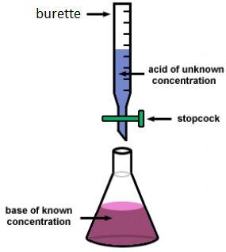
  Reactions of acids – PART 2 - CHEMISTRY ONLY
  Higher
If the volumes of two solutions that react completely are known and the concentrations of one solution is known, the concentration of the other solution can be calculated.
Example:
2NaOH(aq) + H₂SO₄(aq)→ Na₂S0₄(aq) + 2H₂O(l)
It takes 12.20cm³ of sulfuric acid to neutralise 24.00cm³ of sodium hydroxide solution, which has a concentration of 0.50mol/dm³.
Calculate the concentration of the sulfuric acid in g/dm³
0.5 mol/dm³ x (24/1000) dm³ = 0.012 mol of NaOH
The equation shows that 2 mol of NaOH reacts with 1 mol of H₂SO₄, so the number of moles in 12.20cm³ of sulfuric acid is (0.012/2) = 0.006 mol of sulfuric acid
Calculate the concentration of sulfuric acid in mol/ dm³
0.006 mol x (1000/12.2) dm³ =0.49mol/dm³
Calculate the concentration of sulfuric acid in g/ dm³
H₂SO₄ = (2x1) + 32 + (4x16) = 98g
0.49 x 98g = 48.2g/dm³
Notes:
https://www.google.co.uk/url?sa=i&rct=j&q=&esrc=s&source=images&cd=&cad=rja&uact=8&ved=0ahUKEwic9fD53sTVAhXXFsAKHSJ7Dr8QjRwIBw&url=https%3A%2F%2Fdashboard.dublinschools.net%2Flessons%2F%3Fid%3De9c698fd6c35d97ff2e23fd627aef61a&psig=AFQjCNEPUZuHN4PUAqRXuixkOonJ1d2CJw&ust=1502182150450095

Slide 32
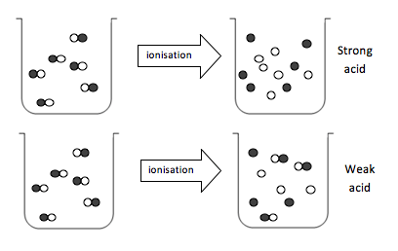
  Reactions of acids - PART 2 - HIGHER
Acids must dissolve in water to show their acidic properties.
A concentrated acid has a relatively large amount of solute dissolved in the solvent. A dilute acid has a relatively smaller amount of solute dissolved in the solvent
The molecules split up to form hydrogen ions.
A strong acid is completely ionised in aqueous solution. E.g. Hydrochloric, nitric and sulfuric acid.
A weak acid is only partially ionised in aqueous solution. E.g. Ethanoic, citric and carbonic.
A weak acid (aq) has a lower pH than a strong acid (aq) of the same concentration.
This is because a weak acid has a lower concentration of hydrogen ions.
As the pH decrease by one unit, the hydrogen ion concentration of the solution increase by a factor of 10.
Concentration of hydrogen ions in mol/dm³ | pH
0.10 | 1.0
0.010 | 2.0
0.0010 | 3.0
0.00010 | 4.0
Notes:
https://www.google.co.uk/url?sa=i&rct=j&q=&esrc=s&source=images&cd=&cad=rja&uact=8&ved=0ahUKEwi728qEqtHVAhWBWBQKHRPTD38QjRwIBw&url=https%3A%2F%2Fdc.edu.au%2Fhsc-chemistry-acidic-environment%2F&psig=AFQjCNG5fBPM30-007AJ_qlijTuBxZFN2g&ust=1502614668234720

Slide 33
QuestionIT!
Reactions of acids
PART 2
  pH and neutralisation
  Titration (chemistry only)
  Strong and weak acids (HT)

Slide 34
  Reactions of acids – QuestionIT
What ions do aqueous acids contain?
What ions do aqueous alkalis contain?
What is the pH scale?
How can pH be measured?
What pH is a neutral solution?
What pH do aqueous acid solutions have?
What pH do aqueous alkali solutions have?

Slide 35
  Reactions of acids – QuestionIT
Write a balanced symbol equation for the reaction between hydrogen ions and hydroxide ions.
CHEMISTRY ONLY: What are the units for the concentration of a solution?
CHEMSITRY ONLY: What is the concentration of a solution that has 40g of solute in 2dm³ of solution?

Slide 36
  Reactions of acids – QuestionIT
HT: What is a strong acid?
HT: Name 3 strong acids.
HT: What is a weak acid?
HT: Name 3 weak acids.
HT: What is a dilute acid?
HT: What happens to the hydrogen ion concentration as the pH decreases by 1?

Slide 37
AnswerIT!
Reactions of acids
PART 2
  pH and neutralisation
  Titration (chemistry only)
  Strong and weak acids (HT)

Slide 38
  Reactions of acids – QuestionIT
What ions do aqueous acids contain?
  H⁺
What ions do aqueous alkalis contain?
  OH⁻
What is the pH scale?
  Measure of the acidity or alkalinity of a solution.
How can pH be measured?
  Universal indicator, pH probe.
What pH is a neutral solution?
  7
What pH do aqueous acid solutions have?
  Less than 7.
What pH do aqueous alkali solutions have?
  More than 7.

Slide 39
  Reactions of acids – QuestionIT
Write a balanced symbol equation for the reaction between hydrogen ions and hydroxide ions.
  H⁺(aq) + OH⁻(aq) → H₂O(l)
CHEMISTRY ONLY: What are the units for the concentration of a solution?
  mol/dm³ or g/dm³
CHEMSITRY ONLY: What is the concentration of a solution that has 40g of solute in 2dm³ of solution?
Concentration = mass ÷ volume = 40 g ÷ 2 dm³ = 20 g/dm³

Slide 40
  Reactions of acids – QuestionIT
HT: What is a strong acid?
  Completely ionised in aqueous solution.
HT: Name 3 strong acids.
  Hydrochloric, nitric, sulfuric.
HT: What is a weak acid?
  Partially ionised in aqueous solution.
HT: Name 3 weak acids.
  Ethanoic, citric, carbonic
HT: What is a dilute acid?
  Contains less solute in the same volume
HT: What happens to the hydrogen ion concentration as the pH decreases by 1?
  Increases by a factor of 10

Slide 41
LearnIT!
KnowIT!
Electrolysis
PART 1
  The process of electrolysis
  Electrolysis of a molten ionic compounds
  Electrolysis of aqueous solutions

Slide 42
  Electrolysis - PART 1
When an ionic compound is melted or dissolved in water, the ions are free to move about the liquid or solution. These liquids and solutions are able to conduct electricity and are called electrolytes. Passing an electric current though electrolytes causes the ions to move to the electrodes.
Direct current (DC) supply
_
+
Positive ions go to negative electrode (cathode) and are reduced (gain of electrons).
Negative ions go to the positive electrode (anode) and are oxidised (loss of electrons).
Ions are discharged at the electrodes producing elements. This is called electrolysis.
Negative electrode (cathode)
Positive electrode (anode)
+
-
-
+
+
-
+
-
+
-

Slide 43
  Electrolysis - PART 1
When an ionic compound is electrolysed in a molten state using inert electrodes, the metal is produced at the cathode and the non-metal is produced at the anode.
lead bromide → lead + bromine
Higher: You can represent what is happening at each electrode using half equations.
_
+
+
-
Bromide ions Br ⁻
Lead ions Pb ⁺
+
-
+
-
+
-
Molten lead (II) bromide
+
-
The positively charged lead ions Pb + (cations) are attracted to cathode and the negatively charged bromide ions Br ⁻ are attracted to the anode.
Higher:
At the cathode
Pb ²⁺ + 2e – → Pb
Higher:
At the anode
2Br ⁻ → Br₂ + 2e – or 2Br ⁻ - 2e ⁻ → Br₂
Notes:
https://bam.files.bbci.co.uk/bam/live/content/zcwngk7/large

Slide 44
  Electrolysis - PART 1
The ions discharged when an aqueous solution is electrolysed using inert electrodes depend on the relative reactivity of the elements involved.
At the negative electrode:
Metal will be produced on the electrode if it is less reactive than hydrogen.
Hydrogen will be produced if the metal is more reactive than hydrogen.
At the positive electrode:
Oxygen is formed at positive electrode.
If you have a halide ion (Cl⁻, I⁻, Br⁻) then you will get chlorine, bromine or iodine formed at that electrode.
This happens because in the aqueous solution, water molecules break down producing hydrogen ions and hydroxide ions that are discharged.
H₂O(l) → H⁺(aq) + OH⁻(aq)
Higher: At the anode
4OH⁻ → O₂ + 2H₂O + 4e⁻
or 4OH⁻ – 4e⁻ → O₂ + 2H₂O
_
+
Chloride Cl ⁻
Hydrogen H⁺
+
+
-
-
Sodium chloride solution
+
-
-
+
+
-
sodium chloride → hydrogen + chlorine
+ sodium hydroxide
Uses of the products:
Chlorine: Bleach and PVC
Hydrogen: Margarine Sodium hydroxide: Bleach and soap
Higher:
At the cathode
2H⁺ + 2e – → H₂
Higher:
At the anode
2Cl ⁻ → Cl₂ + 2e – or 2Cl ⁻ - 2e ⁻ → Cl₂
Notes:
https://bam.files.bbci.co.uk/bam/live/content/zbktvcw/large

Slide 45
QuestionIT!
Electrolysis
PART 1
  The process of electrolysis
  Electrolysis of a molten ionic compounds
  Electrolysis of aqueous solutions

Slide 46
  Electrolysis – QuestionIT
Why can a molten or dissolved ionic compound conduct electricity?
What is electrolysis?
What is the name of the electrode that positive ions move to?
What is the name of the electrode that the negative ions move to?
What is produced at the cathode when lead bromide is electrolysed?
What is produced at the anode when lead bromide is electrolysed?

Slide 47
  Electrolysis – QuestionIT
What is produced at the cathode is the metal in the solution is more reactive than hydrogen?
What is produced at the anode if the solution does not contain halide ions?
HT Only: Write half equations for the reactions that happen at the
electrodes during the electrolysis of molten copper chloride.
10. Predict the products of electrolysis of copper sulfate solution
11. HT Only: Write a half equation for the reactions that happen at the
electrodes during the electrolysis of copper bromide solution.

Slide 48
AnswerIT!
Electrolysis
PART 1
  The process of electrolysis
  Electrolysis of a molten ionic compounds
  Electrolysis of aqueous solutions

Slide 49
  Electrolysis – QuestionIT
Why can a molten or dissolved ionic compound conduct electricity?
  Free moving ions.
What is electrolysis?
  When an electric current is passed through a molten or aqueous ionic solution and the salt breaks down into simpler substances.
What is the name of the electrode that positive ions move to?
  Cathode.
What is the name of the electrode that the negative ions move to?
  Anode.
What is produced at the cathode when lead bromide is electrolysed?
  Lead.
What is produced at the anode when lead bromide is electrolysed?
  Bromine.

Slide 50
  Electrolysis – QuestionIT
What is produced at the cathode is the metal in the solution is more reactive than hydrogen?
  Hydrogen.
What is produced at the anode if the solution does not contain halide ions?
  Oxygen.
HT Only: Write half equations for the reactions that happen at the
electrodes during the electrolysis of molten copper chloride.
Negative electrode: Cu²⁺(aq) + 2e⁻ → Cu(s)
Positive electrode: 2Cl⁻(aq) → Cl₂(g) + 2e⁻
10. Predict the products of electrolysis of copper sulfate solution
Positive electrode: Oxygen gas; Negative electrode: Copper.
11. HT Only: Write a half equation for the reactions that happen at the
electrodes during the electrolysis of copper bromide solution.
Negative electrode: Cu²⁺(aq) + 2e⁻ → Cu(s)
Positive electrode: 2Br⁻(aq) → Br₂(g) + 2e⁻

Slide 51
LearnIT!
KnowIT!
Electrolysis
PART 2
  Using electrolysis to extract metals

Slide 52
  Electrolysis - PART 2
Metals can be extracted from molten compounds using electrolysis.
It is used if the metal is too reactive to be extracted by reduction with carbon or if the metal reacts with carbon.
Large amounts of energy are used in the extraction process to melt the compounds and to produce the electrical current.
Aluminum is manufactured by electrolysis of molten aluminum oxide.
Aluminium oxide → aluminium + oxygen
Aluminium oxide has a very high melting point so is mixed with molten cryolite to lower the temperature required to carry out the electrolysis.
Aluminium goes to the negative electrode and sinks to bottom.
Higher: Al ³⁺ + 3e – → Al
Oxygen forms at positive electrodes.
Higher: 2O ²⁻ → O₂ + 4e –
The oxygen reacts with the carbon electrode making carbon dioxide causing damage. The electrode needs replacing due to this reaction.
C + O₂ → CO₂
Graphite anodes + charge
Steel case
+
+
+
-
-
-
Graphite cathode - charge
Molten aluminium oxide with
cryolite 950 ºC
Molten aluminium
Notes:
https://www.google.co.uk/url?sa=i&rct=j&q=&esrc=s&source=images&cd=&cad=rja&uact=8&ved=0ahUKEwi0wPOphtDVAhUIShQKHW9XD0AQjRwIBw&url=http%3A%2F%2Fibchem.com%2FIB%2Fibnotes%2Ffull%2Fope_htm%2Fhall_cell.htm&psig=AFQjCNGb7-GPpBasXBz55VXk3BCbdFEYPQ&ust=1502570727717402

Slide 53
QuestionIT!
Electrolysis
PART 2
  Using electrolysis to extract metals

Slide 54
  Electrolysis – QuestionIT
Why is electrolysis used to extract aluminium form its ore?
Why is electrolysis an expensive way to extract metal from its ore?
Name the compound from which aluminium is extracted.
What is this compound dissolved in before electrolysis?
What is the anode made of?

Slide 55
  Electrolysis – QuestionIT
Describe what happens at the positive electrode during the electrolysis of aluminium oxide.
HT Only: Write half equations for the reactions that occur at the positive and negative electrodes during the production of aluminium.

Slide 56
AnswerIT!
Electrolysis
PART 2
  Using electrolysis to extract metals

Slide 57
  Electrolysis – QuestionIT
Why is electrolysis used to extract aluminium form its ore?
  Aluminium is more reactive than carbon.
Why is electrolysis an expensive way to extract metal from its ore?
  Large amounts of energy needed.
Name the compound from which aluminium is extracted.
  Aluminium oxide/ bauxite.
What is this compound dissolved in before electrolysis?
  Cryolite.
What is the anode made of?
  Carbon.

Slide 58
  Electrolysis – QuestionIT
Describe what happens at the positive electrode during the electrolysis of aluminium oxide.
Oxide ions give up their electrons to form oxygen atoms, these join together in pairs to form oxygen gas, the oxygen reacts with the carbon electrode to make carbon dioxide gas.
HT Only: Write half equations for the reactions that occur at the positive and negative electrodes during the production of aluminium.
  Positive electrode: 2O²⁻(aq) → O₂(g) + 4e⁻
Negative electrode: Al³⁺(aq) + 3e⁻ → Al(l)

